Slide 1
Spring Data
Computación en Internet II
2023-2

Slide 2
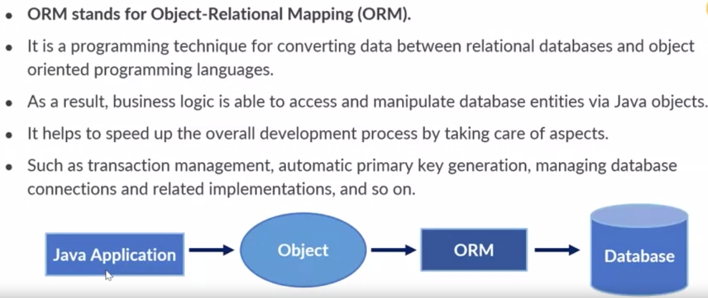
ORM Framework

Slide 3

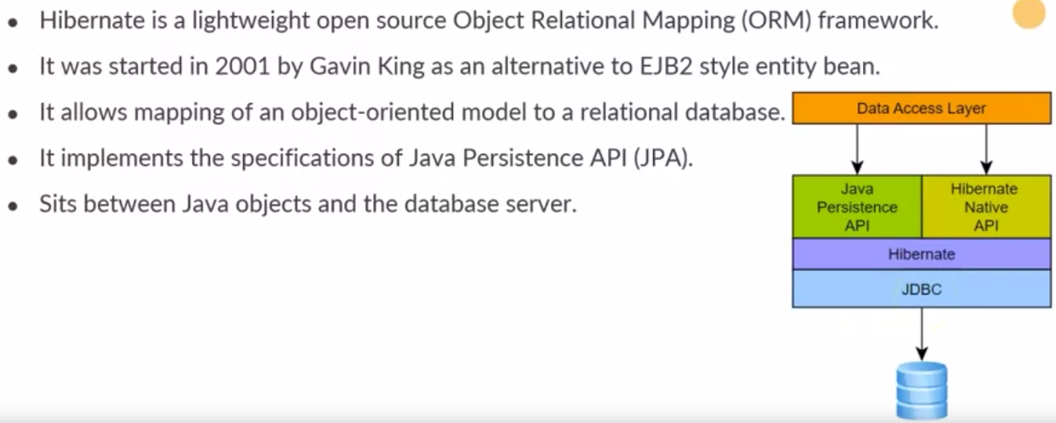
Introduction to Hibernate

Slide 4
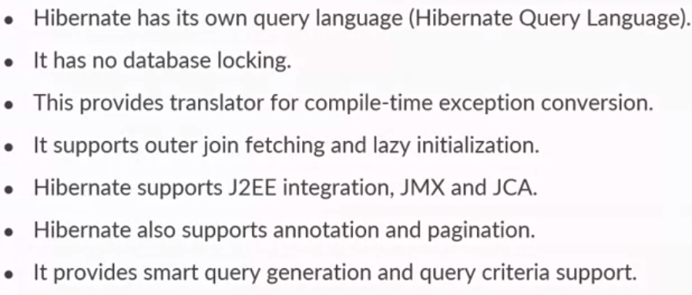
Why Hibernate?

Slide 5
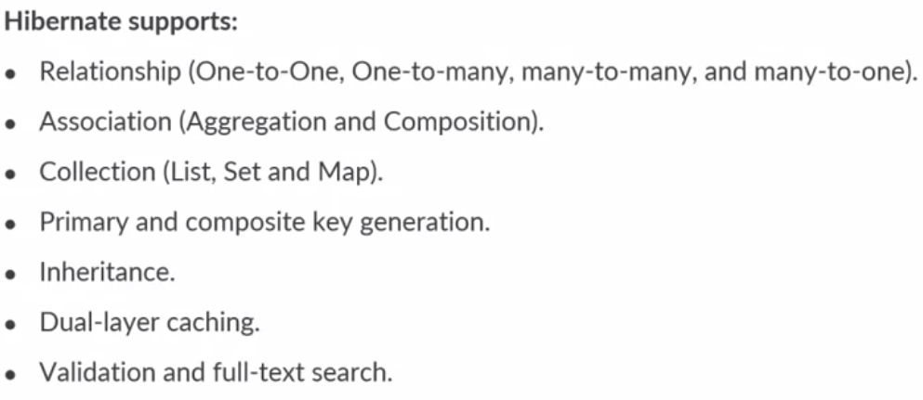
Hibernate

Slide 6
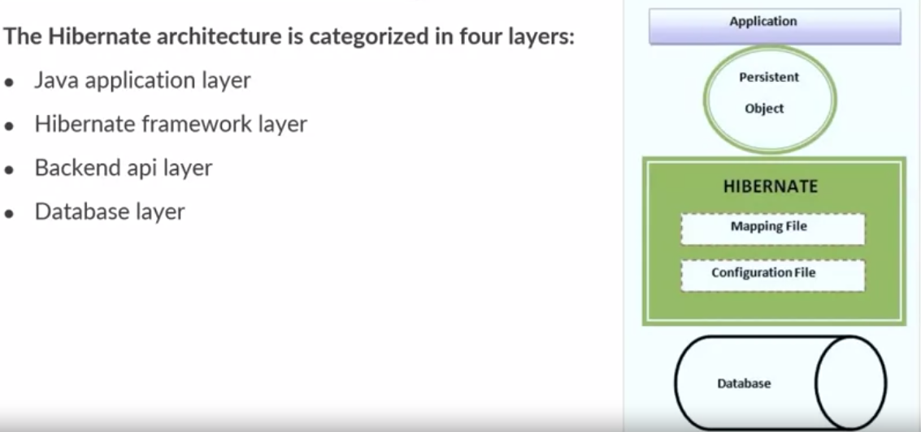
Hibernate Architecture

Slide 7
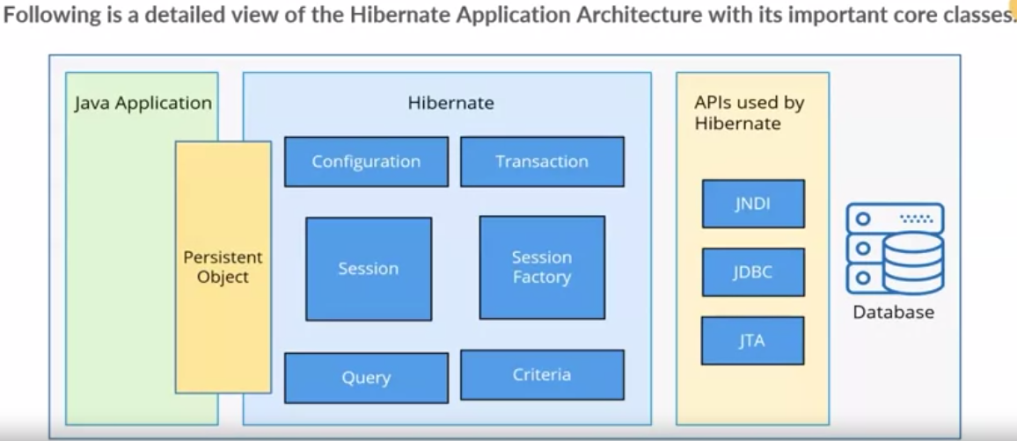
High-Level Hibernate Architecture

Slide 8
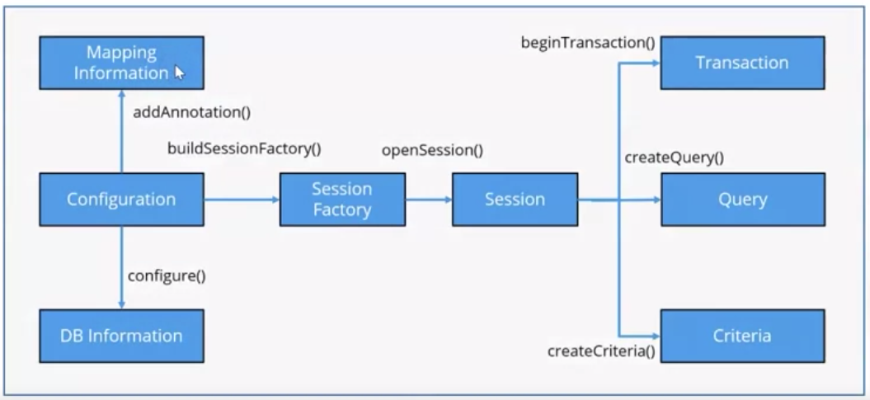
Flow of Hibernate Architecture

Slide 9

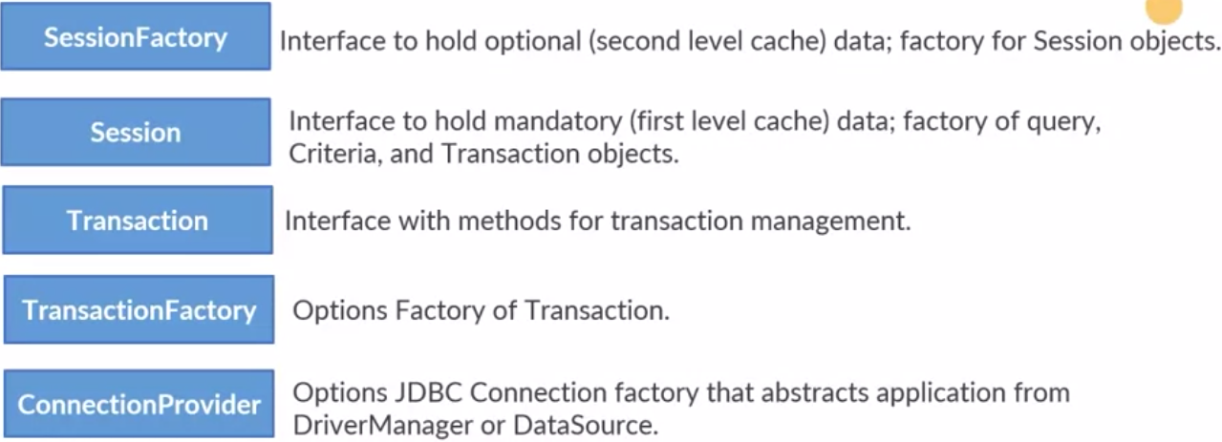
Hibernate Architecture: Elements

Slide 10

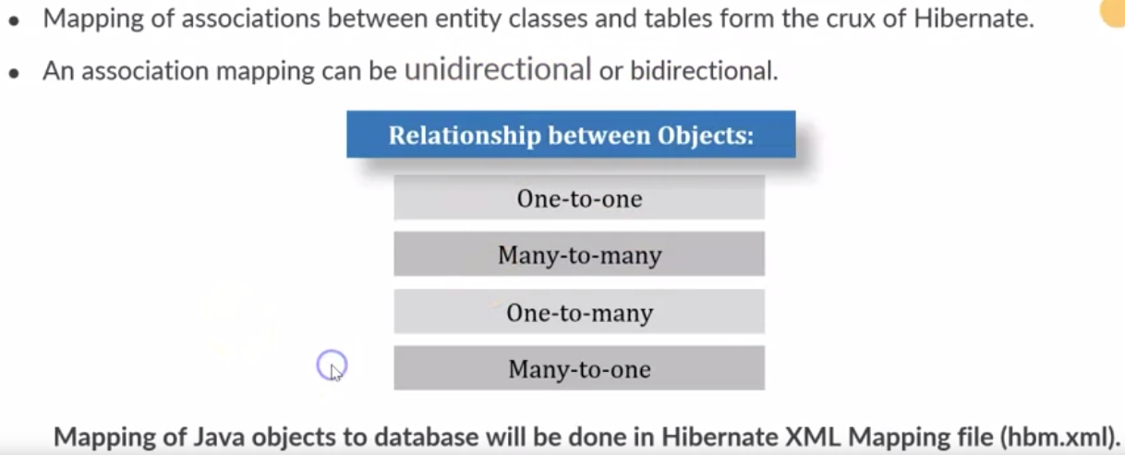
Association Mapping

Slide 11
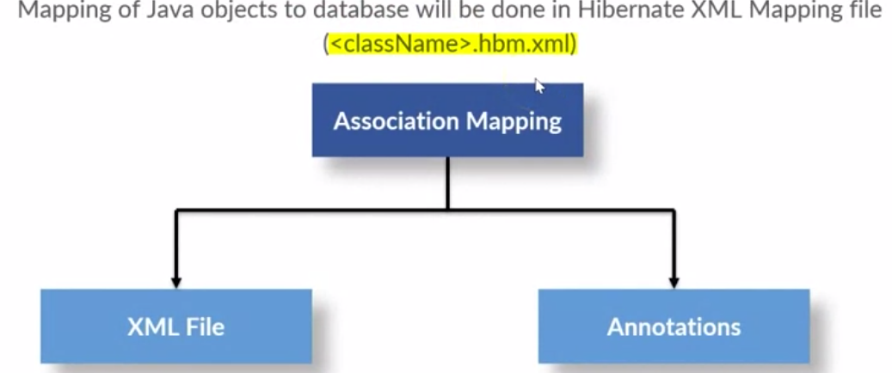

Association Mapping

Slide 12
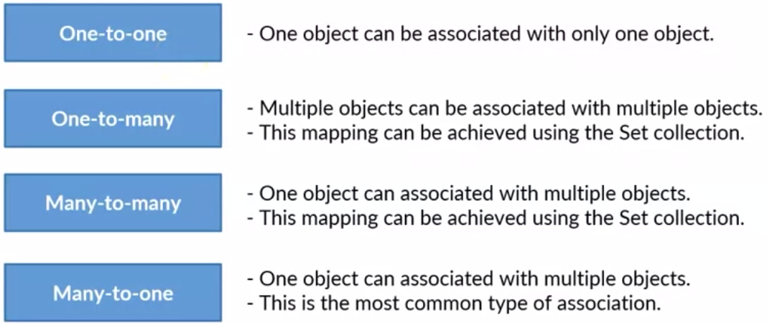
Hibernate Mapping using XML

Slide 13
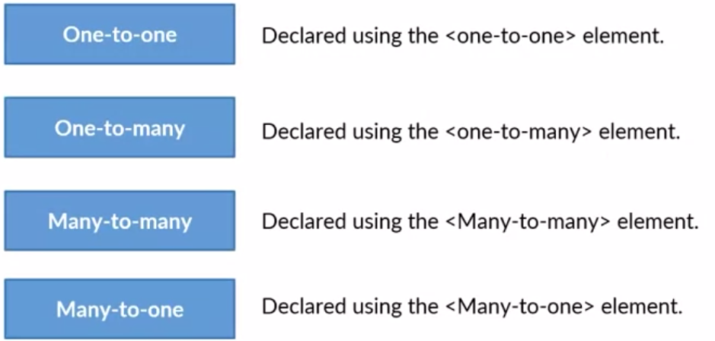
Hibernate Mapping using XML

Slide 14

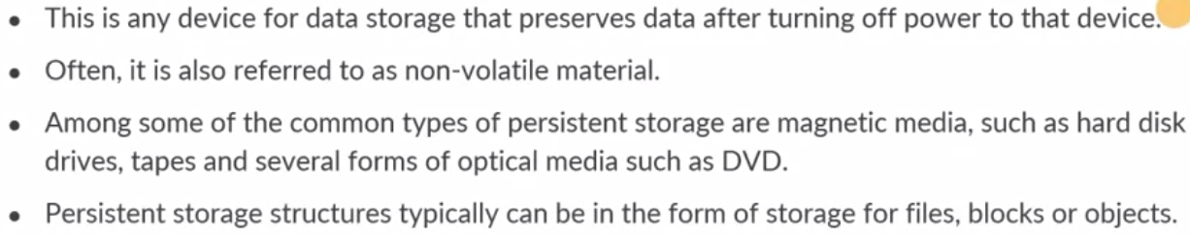
What is persistent storage?

Slide 15
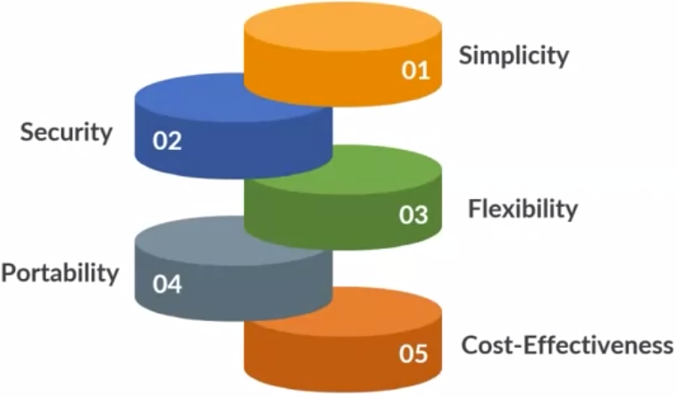
Benefits of persistent storage

Slide 16
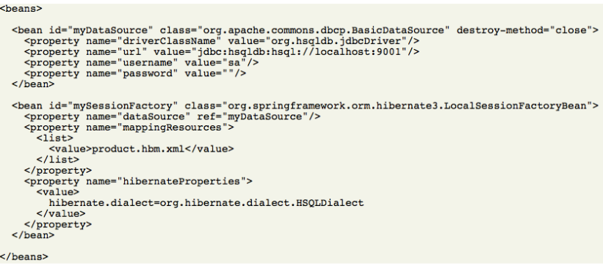

Spring provides Hibernate Support

Slide 17
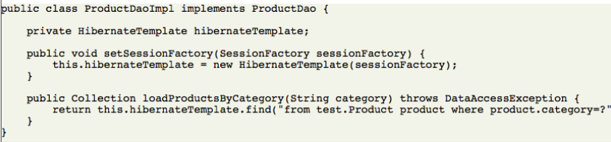
Spring Hibernate Template

Slide 18
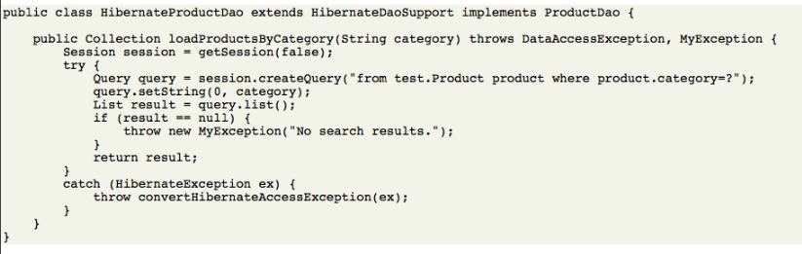
Spring HibernateDaoSupport

Slide 19
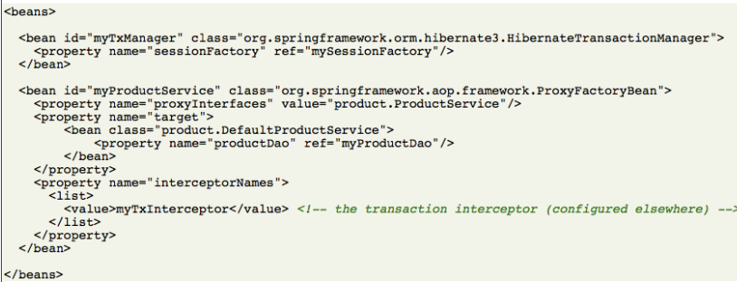
Spring HibernateTransactionManager

Slide 20
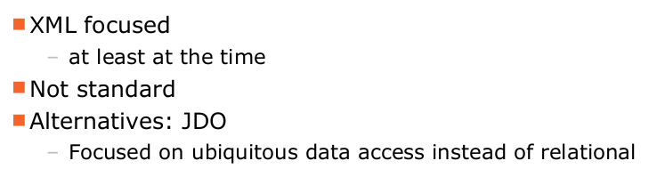
Hibernate Consequences

Slide 21

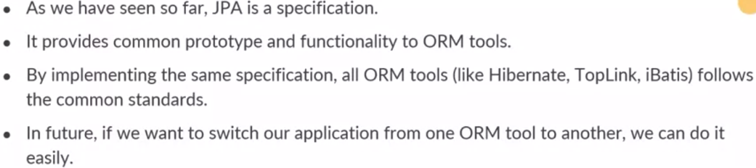
Need of JPA

Slide 22
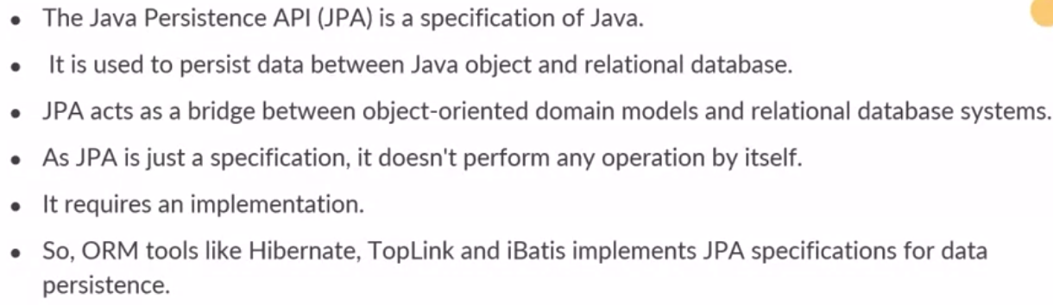
What is JPA?

Slide 23
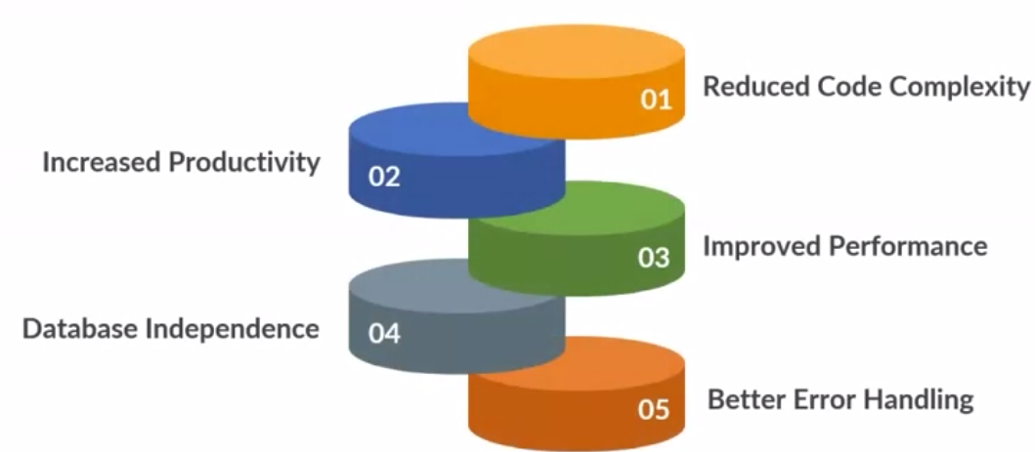
Advantages of JPA

Slide 24
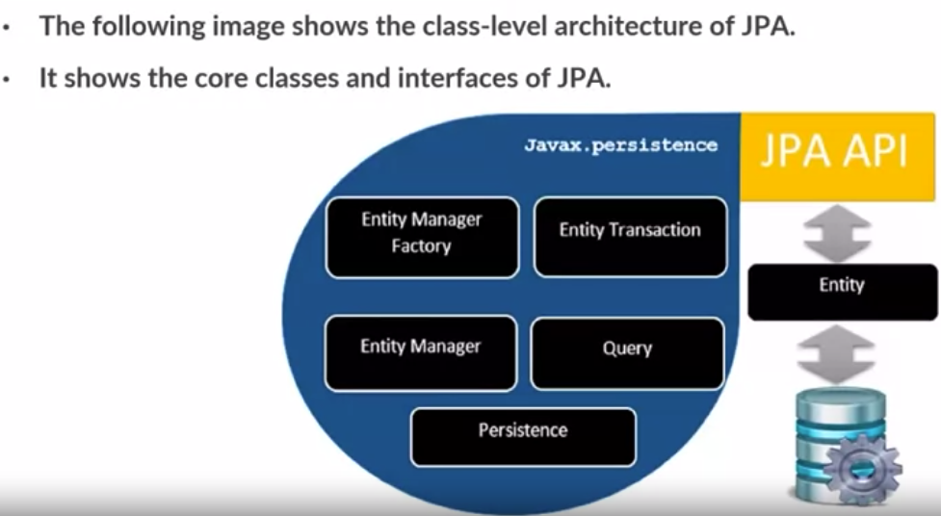
JPA class-level Architecture

Slide 25
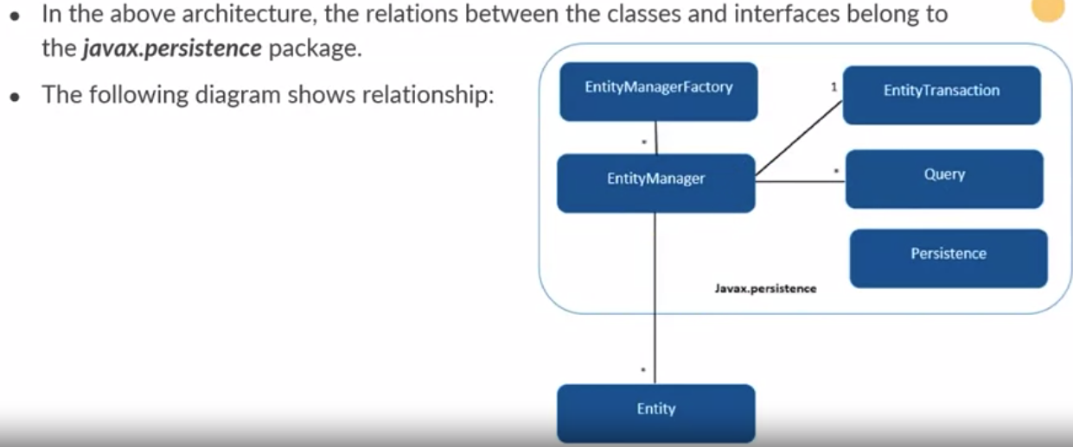
JPA Class RelationShips

Slide 26
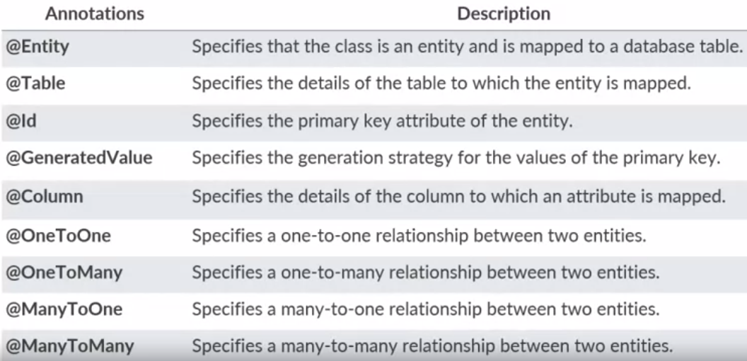
Hibernate JPA Annotations

Slide 27
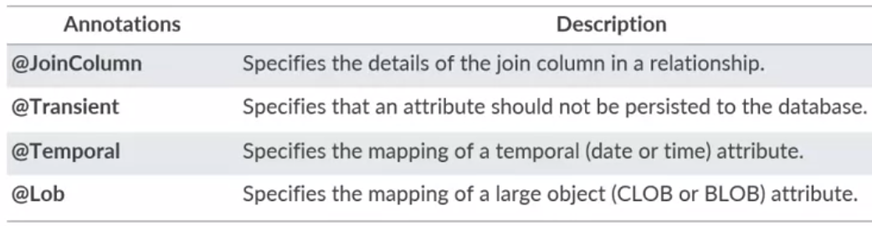
Hibernate JPA Annotations

Slide 28
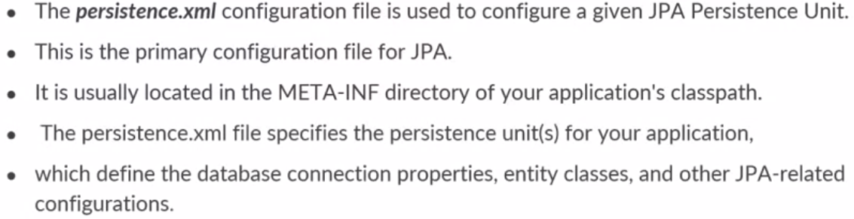
JPA Configuration File

Slide 29
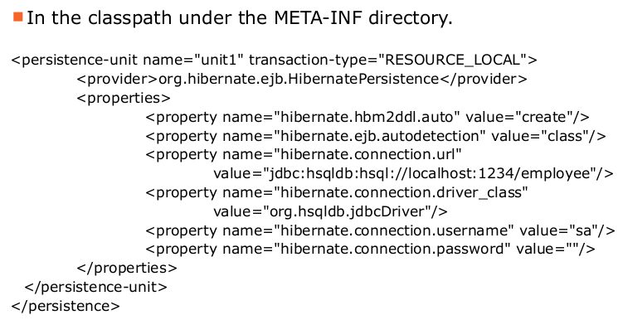
JPA Configuration File

Slide 30
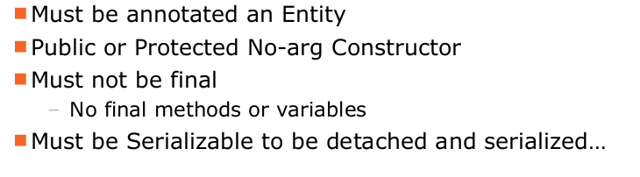
Entity Requirements

Slide 31
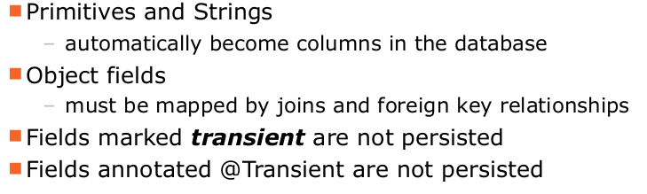
Persistent Fields

Slide 32
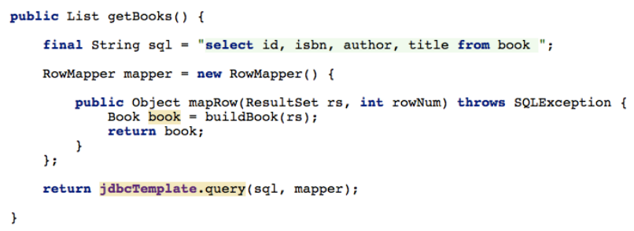
JDBC Template

Slide 33
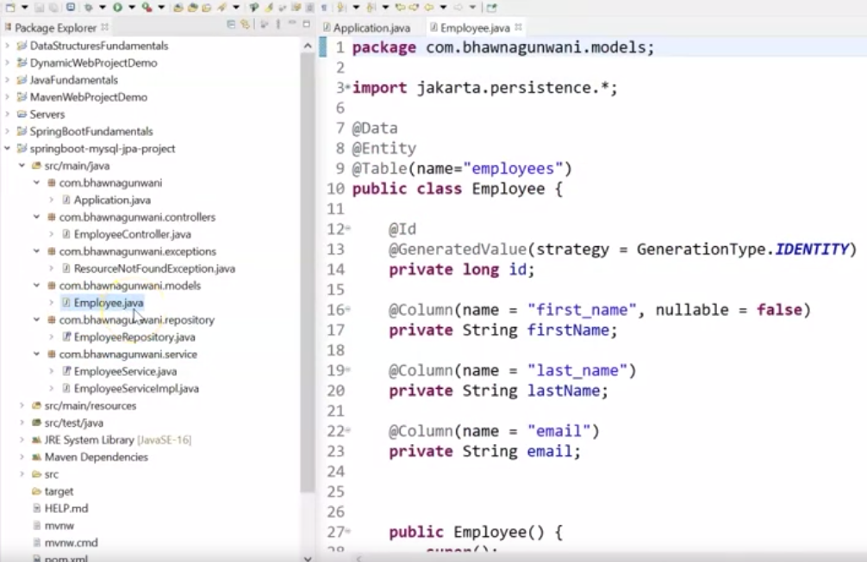

Slide 34
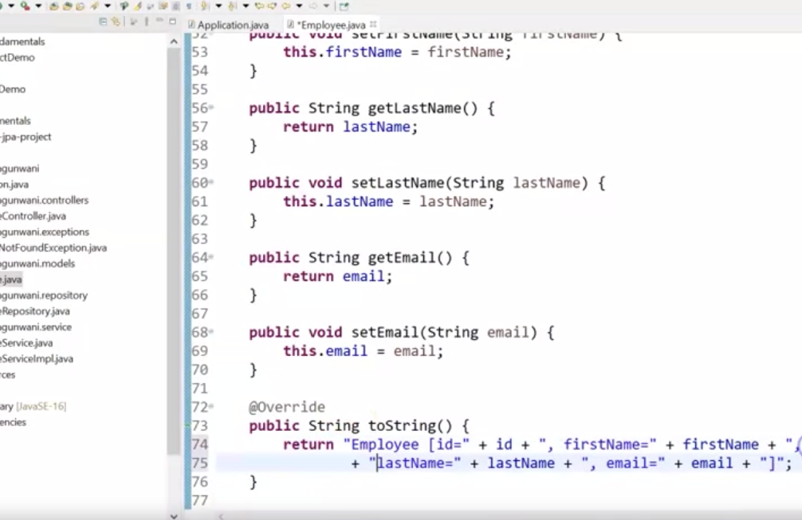

Slide 35
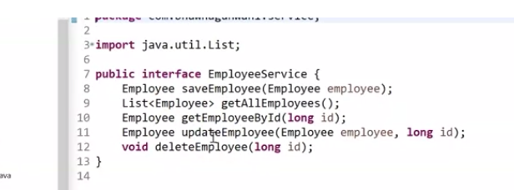

Slide 36
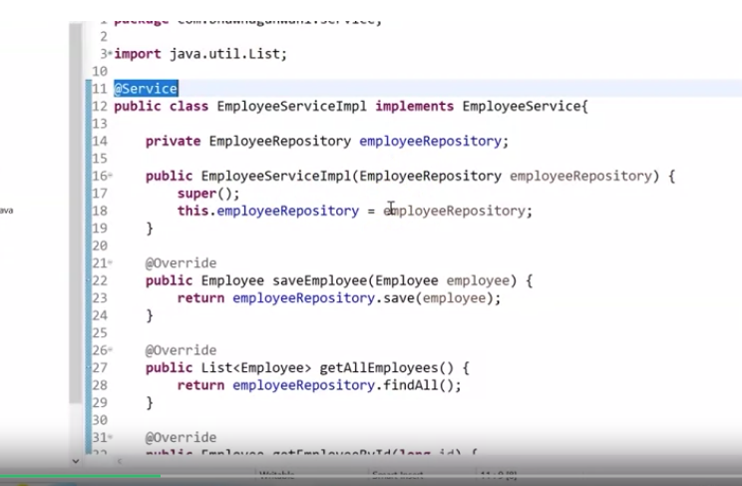

Slide 37
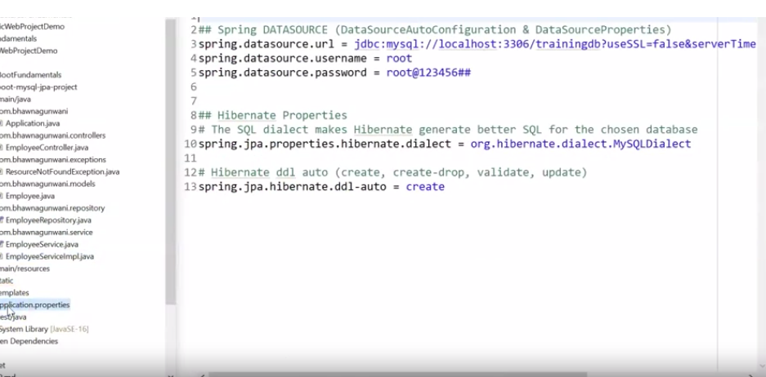

Slide 38
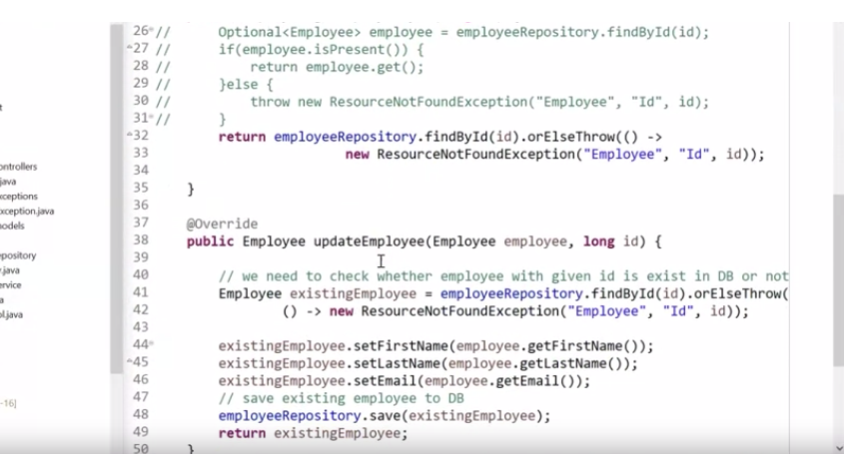

Slide 39
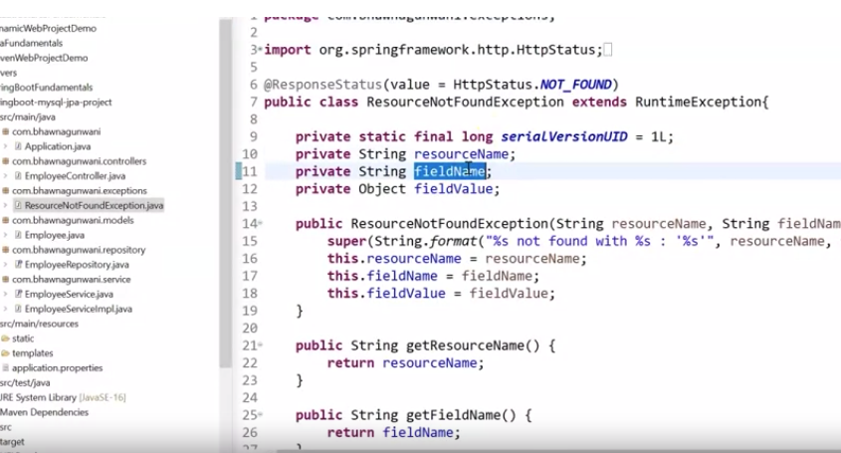

Slide 40
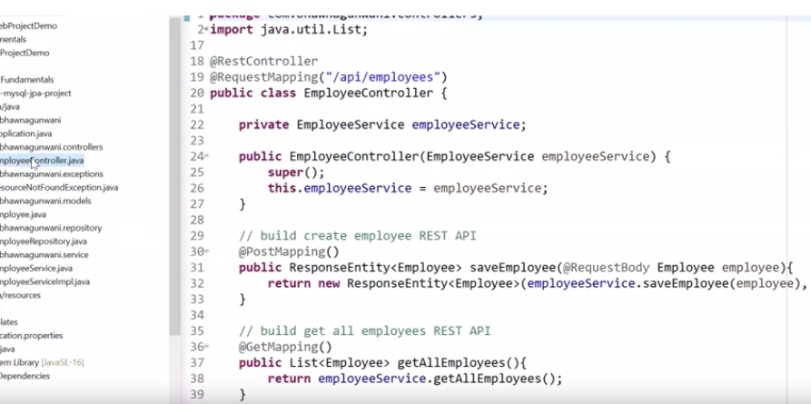

Slide 41
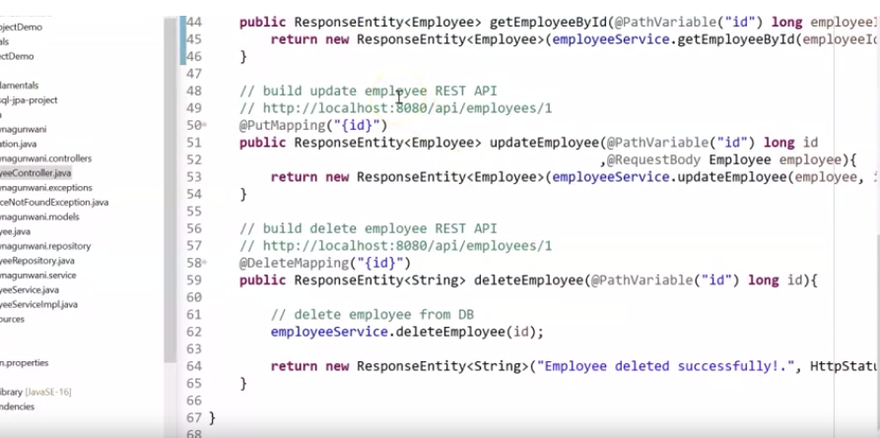

Slide 42
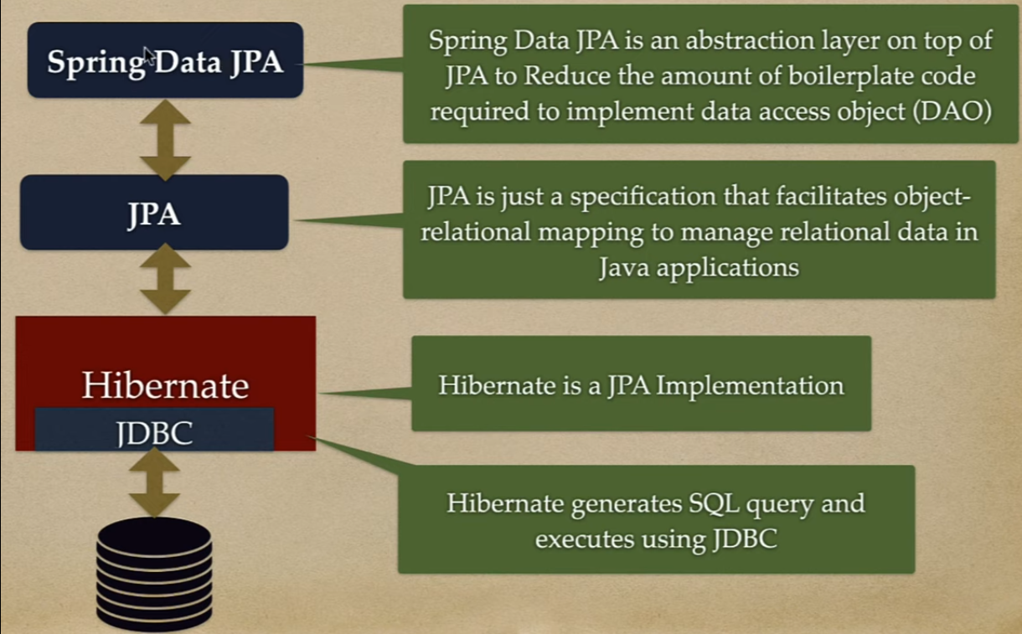

Slide 43
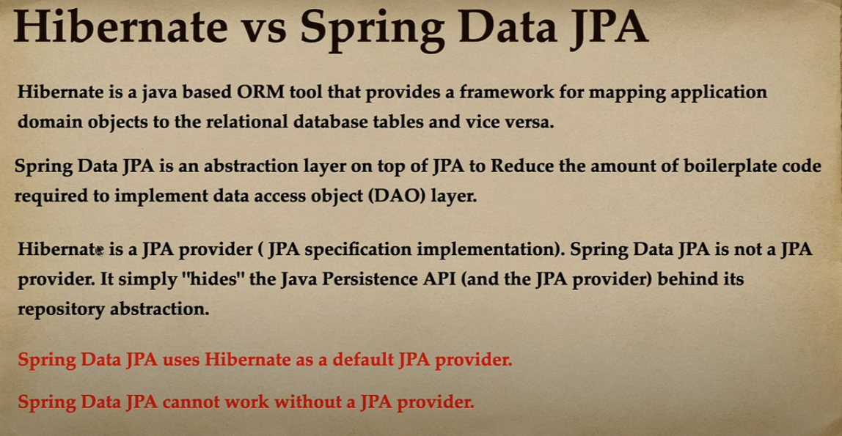

Slide 44
Readings and Videos
https://www.jetbrains.com/idea/guide/tutorials/getting-started-spring-data-jpa/creating-spring-boot-project/
https://www.youtube.com/watch?v=QJddHc41xrM
https://www.youtube.com/playlist?list=PLGRDMO4rOGcPtMMl1DD2cu3GBPZloHOS_
https://www.baeldung.com/jpa-hibernate-persistence-context
https://www.javatpoint.com/jpa-introduction
https://www.freecodecamp.org/news/what-is-an-orm-the-meaning-of-object-relational-mapping-database-tools/

